Slide 1
Dot Product

Slide 2
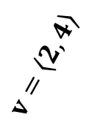
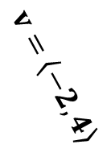

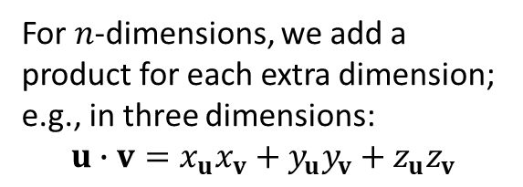
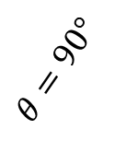



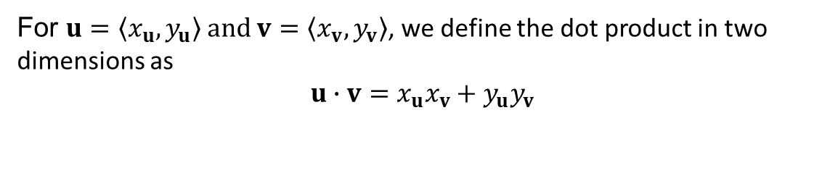
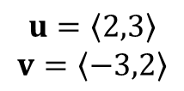





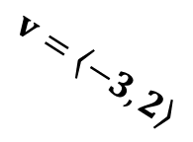


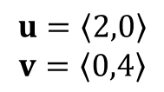
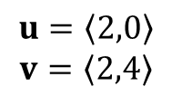
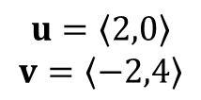
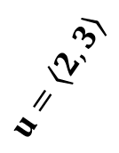
Algebraic Definition
The dot product is an operation that combines two vectors and results in a scalar.
For $u=\left\langle x_{u},y_{u}\right\rangle$ and $v=\left\langle x_{v},y_{v}\right\rangle$, we define the dot product in two dimensions as
$$u∙v={x_{u}x}_{v}+{y_{u}y}_{v}$$
For $n$-dimensions, we add a product for each extra dimension; e.g., in three dimensions:
$$u∙v={x_{u}x}_{v}+{y_{u}y}_{v}+{z_{u}z}_{v}$$
Problem. Compute the dot product and graph the vectors in each case.
$$u=\left\langle 2,0\right\rangle$$
$$v=\left\langle 0,4\right\rangle$$
$$u=\left\langle 2,0\right\rangle$$
$$v=\left\langle 2,4\right\rangle$$
$$u=\left\langle 2,0\right\rangle$$
$$v=\left\langle −2,4\right\rangle$$
$$u=\left\langle 2,3\right\rangle$$
$$v=\left\langle −3,2\right\rangle$$
$$u∙v=0$$
$$u∙v=4$$
$$u∙v=−4$$
$$u∙v=−6+6=0$$
$$v=\left\langle 0,4\right\rangle$$
$$v=\left\langle −3,2\right\rangle$$
$$v=\left\langle 2,4\right\rangle$$
$$θ=90°$$
$$θ≈77.1°$$
$$v=\left\langle −2,4\right\rangle$$
$$θ≈102.9°$$
$$θ=90°$$
$$u=\left\langle 2, 0\right\rangle$$
$$u=\left\langle 2, 0\right\rangle$$
$$u=\left\langle 2, 0\right\rangle$$
$$u=\left\langle 2, 3\right\rangle$$

Slide 3



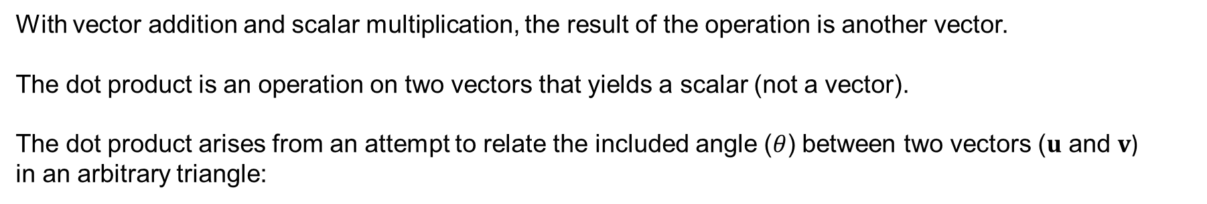



Geometric Interpretation
With vector addition and scalar multiplication, the result of the operation is another vector.
The dot product is an operation on two vectors that yields a scalar (not a vector).
The dot product arises from an attempt to relate the included angle ($θ$) between two vectors ($u$ and $v$)
in an arbitrary triangle:
$$u−v$$
$$u$$
$$θ$$
$$v$$
Using the Law of Cosines (omitted here), we can derive the following useful equation:
$$u∙v=\left\|u\right\|\left\|v\right\|\cos{θ}$$
$u∙v=\cos{θ}$ when $u$ and $v$ are unit vectors.

Slide 4
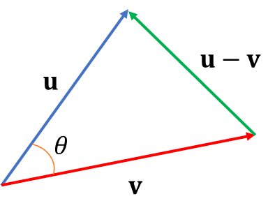
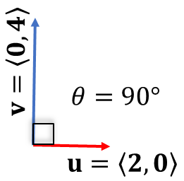

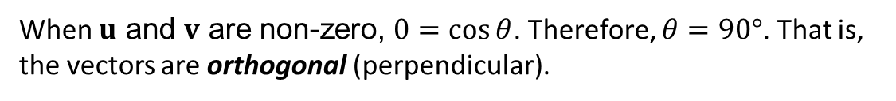



Dot Product and "Pointing"
$$u∙v=\left\|u\right\|\left\|v\right\|\cos{θ}$$
We can think of $u∙v$ as measuring the extent to which $u$ and $v$ point in the same direction.
What is the relationship between $u$ and $v$ when the dot product is zero?
$u$ may be the zero vector
$v$ may be the zero vector
When $u$ and $v$ are non-zero, $0=\cos{θ}$. Therefore, $θ=90°$. That is, the vectors are orthogonal (perpendicular).

Slide 5



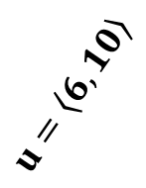

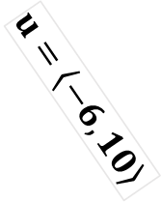

Dot Product and "Pointing" II
$$u∙v=\left\|u\right\|\left\|v\right\|\cos{θ}$$
What is the relationship between $u$ and $v$ when the dot product is positive?
We observe: vector magnitudes are always positive.
Therefore, if $u∙v>0$, it follows $\cos{θ}>0$. This occurs when $0<θ<90°$.
$$u=\left\langle 6,10\right\rangle$$
$$θ≈59°$$
What is the relationship between $u$ and $v$ when the dot product is negative?
$$v=\left\langle 3, 0\right\rangle$$
If $u∙v<0$, it follows $\cos{θ}<0$. This occurs when $90<θ<180°$.
$$u=\left\langle −6,10\right\rangle$$
$$θ≈121°$$
$$v=\left\langle 3, 0\right\rangle$$

Slide 6












Dot Product and "Pointing" III
Problem. Draw two situations: when $\cos{θ}=−1$ and when $\cos{θ}=1$.
Express the relationship between the dot product and magnitudes of the vector.
$$u∙v=\left\|u\right\|\left\|v\right\|\cos{θ}$$
Solution.
When is $\cos{θ}=−1$? When $θ=180°$.
When is $\cos{θ}=1$? When $θ=0°$.
$u$ and $v$ are parallel in the opposite direction.
$u$ and $v$ are parallel in the same direction.
$$θ=180°$$
$$θ=0°$$
$$u=\left\langle −10, 0\right\rangle$$
$$v=\left\langle 3, 0\right\rangle$$
$$u=\left\langle 10, 0\right\rangle$$
$$v=\left\langle 3, 0\right\rangle$$
$$u∙v=−\left\|u\right\|\left\|v\right\|$$
$$u∙v=\left\|u\right\|\left\|v\right\|$$

Slide 7

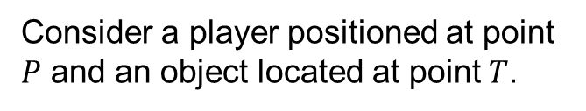

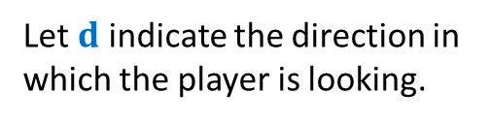

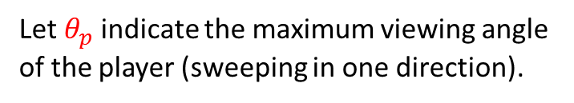




$$u∙v=\left\|u\right\|\left\|v\right\|\cos{θ}$$
Application: Can I See it?
A few common, game-based questions:
Is an object in the field of view of a player?
Can an AI bot see a player?
Can the main character see an object? If so, highlight that object.
$$T$$
$$θ_{t}$$
$$d$$
$$θ_{p}$$
$$P$$
Consider a player positioned at point $P$ and an object located at point $T$.
Let $d$ indicate the direction in which the player is looking.
Let$θ_{p}$ indicate the maximum viewing angle of the player (sweeping in one direction).
The question of "Can we view an object?" is really a question about angles between vectors.
Construct vector $\vec{PT}$ with angle $θ_{t}$ between the direction the player is looking ($d$) and the vector toward the object ($\vec{PT}$).
An object is viewable if $θ_{t}<θ_{p}$ or more commonly:
$$\cos{θ_{t}}>\cos{θ_{p}}$$

Slide 8
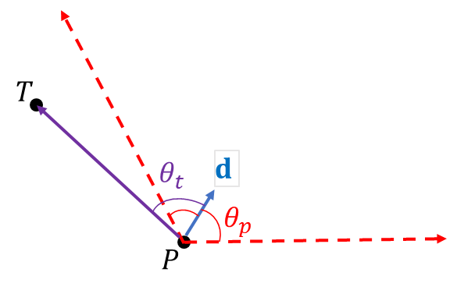
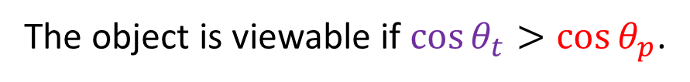
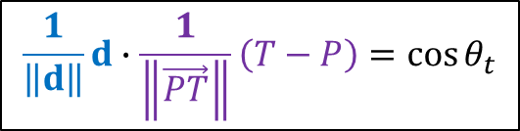
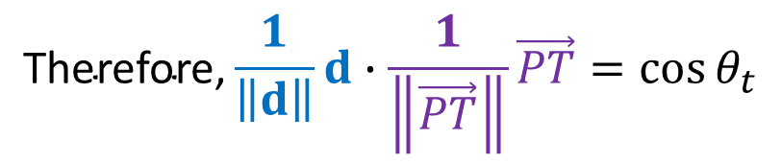
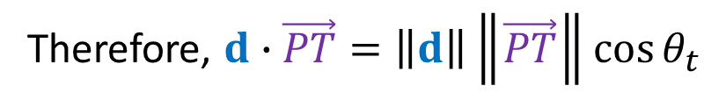
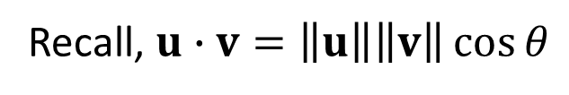
Can I See it? (cont.)
Recall, $u∙v=\left\|u\right\|\left\|v\right\|\cos{θ}$
Therefore, $d∙\vec{PT}=\left\|d\right\|\left\|\vec{PT}\right\|\cos{θ_{t}}$
Recall $u∙v=\cos{θ}$ when $u$ and $v$ are unit vectors.
We must normalize$d$ and $\vec{PT}$, respectively: $\frac{1}{\left\|d\right\|}d$ and $\frac{1}{\left\|\vec{PT}\right\|}\vec{PT}$.
$$\text{Therefore}\text{,}\frac{1}{\left\|d\right\|}d∙\frac{1}{\left\|\vec{PT}\right\|}\vec{PT}=\cos{θ_{t}}$$
$$\frac{1}{\left\|d\right\|}d∙\frac{1}{\left\|\vec{PT}\right\|}\left(T−P\right)=\cos{θ_{t}}$$
The object is viewable if $\cos{θ_{t}}>\cos{θ_{p}}$.

Slide 9
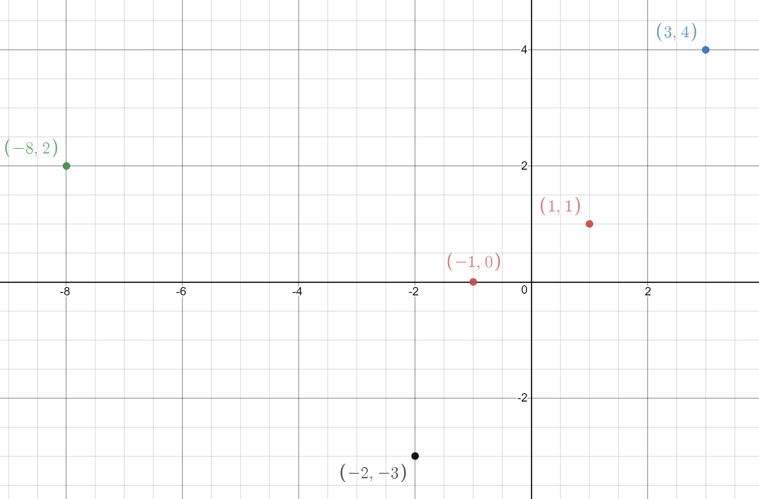

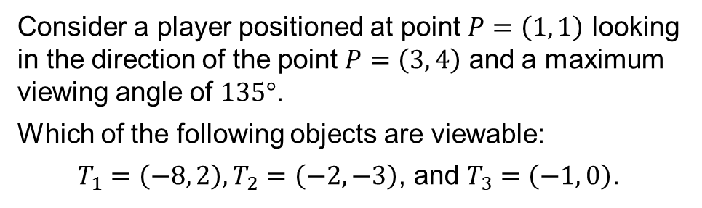




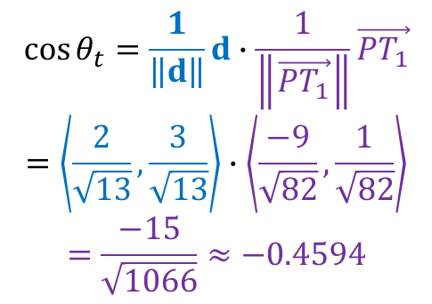
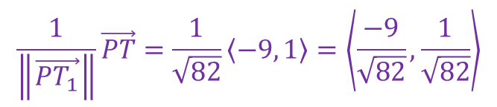
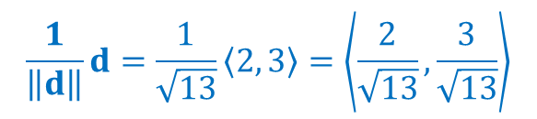

Can I See it? Example
Consider a player positioned at point $P=\left(1, 1\right)$ looking in the direction of the point $P=\left(3, 4\right)$ and a maximum viewing angle of $135°$.
Which of the following objects are viewable:
$T_{1}=\left(−8, 2\right),T_{2}=\left(−2, −3\right)$, and $T_{3}=\left(−1, 0\right)$.
$$θ_{t}$$
$$d$$
$$θ_{p}=135°$$
Solution.
$$d=\left\langle 3−1, 4−1\right\rangle =\left\langle 2, 3\right\rangle$$
$$\frac{1}{\left\|d\right\|}d=\frac{1}{\sqrt{13}}\left\langle 2, 3\right\rangle =\left\langle \frac{2}{\sqrt{13}},\frac{3}{\sqrt{13}}\right\rangle$$
$$\cos{θ_{t}}=\frac{1}{\left\|d\right\|}d∙\frac{1}{\left\|\vec{PT_{1}}\right\|}\vec{PT_{1}}$$
$$=\left\langle \frac{2}{\sqrt{13}},\frac{3}{\sqrt{13}}\right\rangle ∙\left\langle \frac{−9}{\sqrt{82}},\frac{1}{\sqrt{82}}\right\rangle$$
$$=\frac{−15}{\sqrt{1066}}≈−0.4594$$
$$\cos{θ_{p}}=\cos{135°}≈−0.7071$$
$$\vec{PT_{1}}=\left\langle −8−1, 2−1\right\rangle =\left\langle −9,1\right\rangle$$
$$\frac{1}{\left\|\vec{PT_{1}}\right\|}\vec{PT}=\frac{1}{\sqrt{82}}\left\langle −9, 1\right\rangle =\left\langle \frac{−9}{\sqrt{82}},\frac{1}{\sqrt{82}}\right\rangle$$
The object is viewable since $\cos{θ_{t}=−0.4594}>−0.7071=cos{θ_{p}}$.

Slide 10


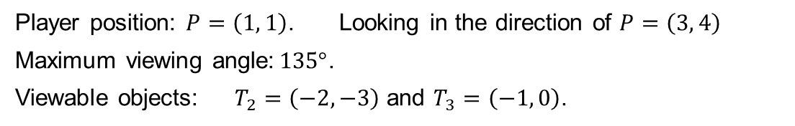

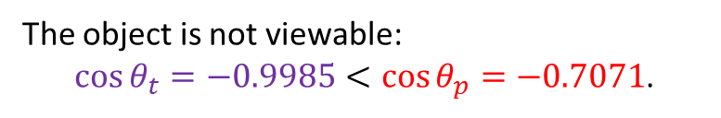

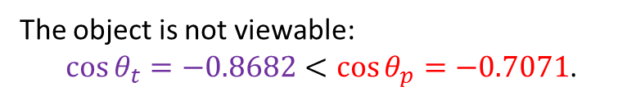


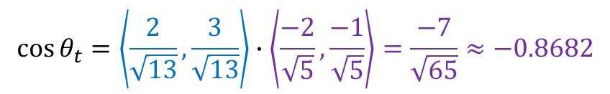
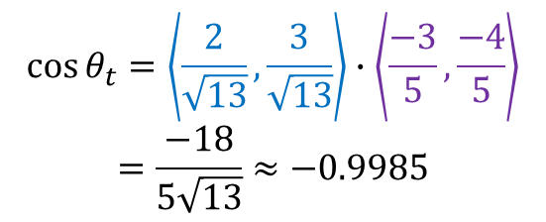
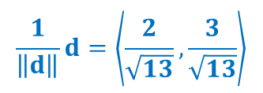
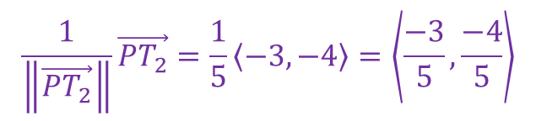
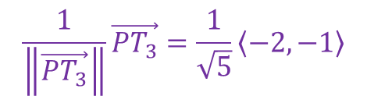
Can I See it? Example (cont.)
Player position: $P=\left(1, 1\right)$. Looking in the direction of $P=\left(3, 4\right)$
Maximum viewing angle:$135°$.
Viewable objects: $T_{2}=\left(−2, −3\right)$ and $T_{3}=\left(−1, 0\right)$.
$$\frac{1}{\left\|d\right\|}d=\left\langle \frac{2}{\sqrt{13}},\frac{3}{\sqrt{13}}\right\rangle$$
$$θ_{t}$$
$$d$$
$$θ_{p}=135°$$
Solution.
$$\cos{θ_{p}}=\cos{135°}≈−0.7071$$
$$\vec{PT_{2}}=\left\langle −2−1, −3−1\right\rangle =\left\langle −3,−4\right\rangle$$
$$\frac{1}{\left\|\vec{PT_{2}}\right\|}\vec{PT_{2}}=\frac{1}{5}\left\langle −3, −4\right\rangle =\left\langle \frac{−3}{5},\frac{−4}{5}\right\rangle$$
$$\vec{PT_{3}}=\left\langle −1−1, 0−1\right\rangle =\left\langle −2,−1\right\rangle$$
$$\frac{1}{\left\|\vec{PT_{3}}\right\|}\vec{PT_{3}}=\frac{1}{\sqrt{5}}\left\langle −2, −1\right\rangle$$
$$\cos{θ_{t}}=\left\langle \frac{2}{\sqrt{13}},\frac{3}{\sqrt{13}}\right\rangle ∙\left\langle \frac{−3}{5},\frac{−4}{5}\right\rangle$$
$$=\frac{−18}{5\sqrt{13}}≈−0.9985$$
$$\cos{θ_{t}}=\left\langle \frac{2}{\sqrt{13}},\frac{3}{\sqrt{13}}\right\rangle ∙\left\langle \frac{−2}{\sqrt{5}},\frac{−1}{\sqrt{5}}\right\rangle =\frac{−7}{\sqrt{65}}≈−0.8682$$
The object is not viewable:
$\cos{θ_{t}=−0.8682}<\cos{θ_{p}=−0.7071}$.
The object is not viewable:
$\cos{θ_{t}=−0.9985}<\cos{θ_{p}=−0.7071}$.

Slide 11
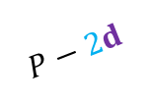


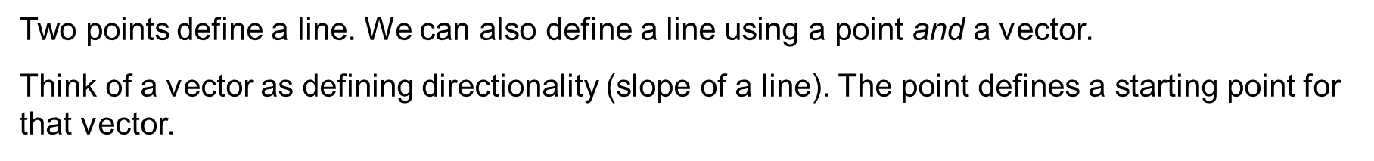


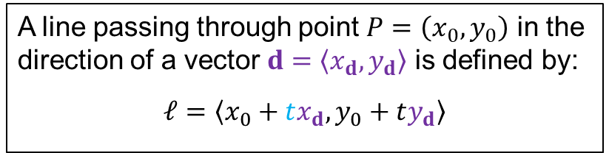
Lines as Vectors
Two points define a line. We can also define a line using a point and a vector.
Think of a vector as defining directionality (slope of a line). The point defines a starting point for that vector.
Since a vector ($d$) and all scalar multiples have the same slope, we may consider any scalar $t$ of a vector $d$: $td$.
$$ℓ$$
$$P−2d$$
$$P$$
A line passing through point $P=\left(x_{0},y_{0}\right)$ in the direction of a vector $d=\left\langle x_{d}, y_{d}\right\rangle$ is defined by:
$$ℓ=\left\langle x_{0}+tx_{d},y_{0}+ty_{d}\right\rangle$$
$$d$$
Note: Do not combine points and vectors directly; think of them as different datatypes.

Slide 12
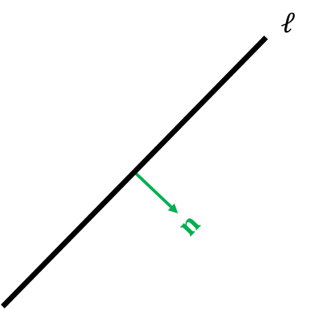
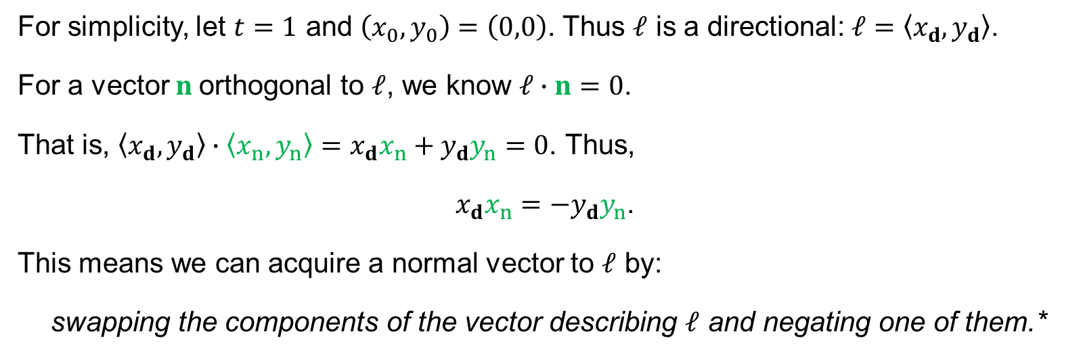
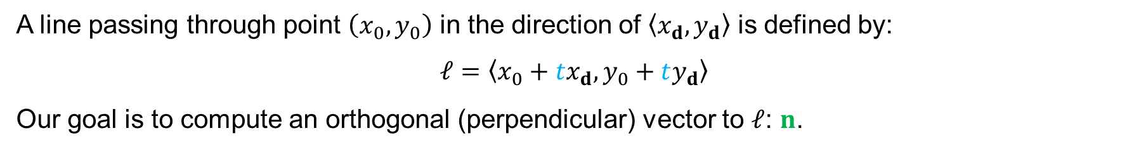

Computing a Normal Vector
A line passing through point $\left(x_{0},y_{0}\right)$ in the direction of $\left\langle x_{d}, y_{d}\right\rangle$ is defined by:
$$ℓ=\left\langle x_{0}+tx_{d},y_{0}+ty_{d}\right\rangle$$
Our goal is to compute an orthogonal (perpendicular) vector to $ℓ$: $n$.
We call $n$ a normal vector to $ℓ$.
For simplicity, let $t=1$ and $\left(x_{0},y_{0}\right)=\left(0,0\right)$. Thus $ℓ$ is a directional: $ℓ=\left\langle x_{d},y_{d}\right\rangle$.
For a vector $n$orthogonal to $ℓ$, we know $ℓ∙n=0$.
That is, $\left\langle x_{d},y_{d}\right\rangle ∙\left\langle x_{n},y_{n}\right\rangle =x_{d}x_{n}+y_{d}y_{n}=0\text{.}$Thus,
$x_{d}x_{n}=−y_{d}y_{n}$.
This means we can acquire a normal vector to $ℓ$ by:
swapping the components of the vector describing $ℓ$ and negating one of them.*
*This does not work if we are dealing with the zero vector.

Slide 13
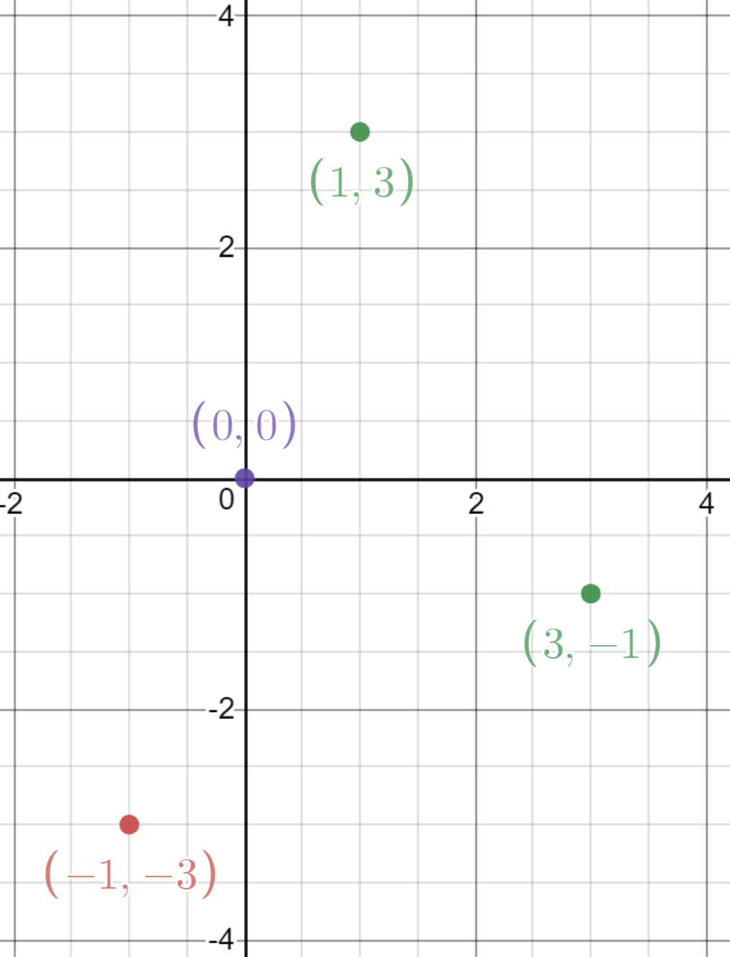




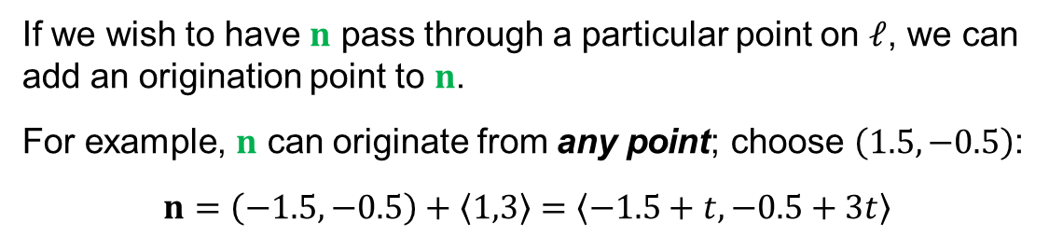


Computing a Normal Vector: Example
Acquire a normal vector by swapping the vector components and negating one of them.
Compute a normal vector to a line in the direction of $\left\langle 3, −1\right\rangle$.
Solution.
$$ℓ=\left\langle 3t,−t\right\rangle$$
With $t=1$, $ℓ=\left\langle 3, −1\right\rangle$.
$$n$$
We acquire a normal vector as
$n=\left\langle −1, −3\right\rangle$ or $n=\left\langle 1, 3\right\rangle$.
$$ℓ$$
$$n$$
If we wish to have $n$ pass through a particular point on $ℓ$, we can add an origination point to $n$.
For example, $n$ can originate from any point; choose $\left(1.5, −0.5\right)$:
$$n=\left(−1.5, −0.5\right)+\left\langle 1,3\right\rangle =\left\langle −1.5+t,−0.5+3t\right\rangle$$

Slide 14





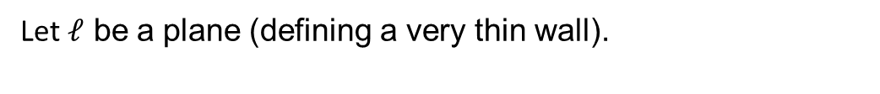







Sides of a Plane
Can we detect if a projectile has impacted a wall or a pane of glass? Projectile positions occur at discrete intervals (via an Update or FixedUpdate function).
Let $ℓ$ be a plane (defining a very thin wall).
$$u$$
Consider a target $t$ traveling toward $ℓ$ at different time intervals.
$$ℓ$$
Can we establish in a call to Update 'when' the projectile passes through the wall?
$$t_{5}$$
$$u∙v>0$$
$$t_{4}$$
Compute vectors $T_{n}$ using the point that defines the normal (intersection of $ℓ$ and $u$).
$$t_{3}$$
$$t_{2}$$
$$u∙v<0$$
We may then compute the dot product between $T_{n}$ and $u$.
$$t_{1}$$
When the dot product changes signs, the projectile is on the opposite side of $ℓ$.

